Slide 1
Electrical HW
John Eley – Rust Embedded Spring 2025

Slide 2
Contents of this template
You can delete this slide when you’re done editing the presentation
Fonts | To view this template correctly in PowerPoint, download and install the fonts we used
Used and alternative resources | An assortment of graphic resources that are suitable for use in this presentation
Thanks slide | You must keep it so that proper credits for our design are given
Colors | All the colors used in this presentation
Icons and infographic resources | These can be used in the template, and their size and color can be edited
Editable presentation theme | You can edit the master slides easily. For more info, click here
For more info: Slidesgo | Blog | FAQs
You can visit our sister projects: Freepik | Flaticon | Storyset | Wepik | Videvo

Slide 3
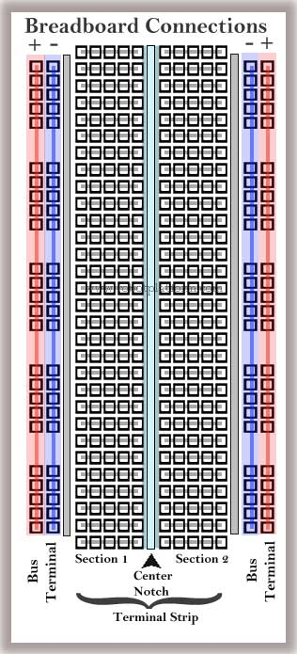
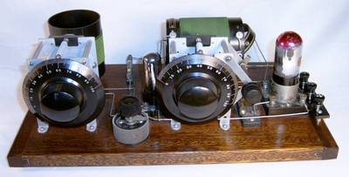
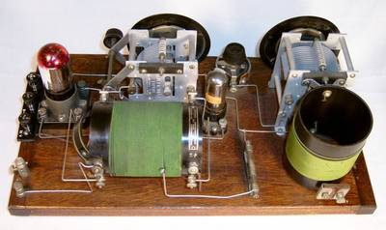
Breadboards
Originally named for the early use of actual wood cutting boards were to wire up electrical circuits.
Modern Proto Breadboard
Vertical Sections
Typically used for power and ground connections
Horizontal Sections
Used to connect component pins
Sparkfun Breadboard Intro

Slide 4
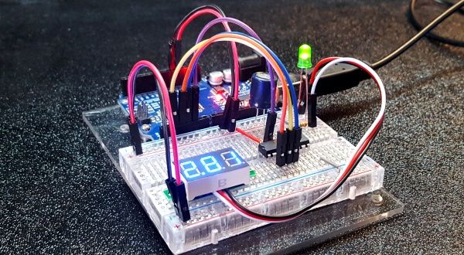
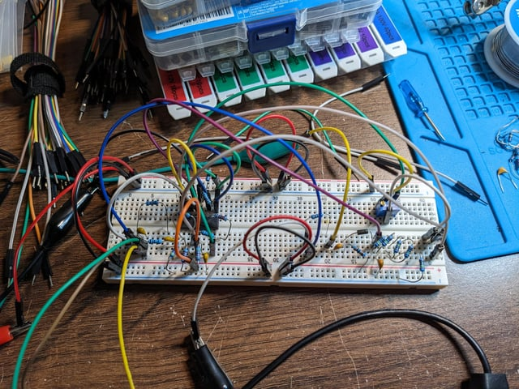
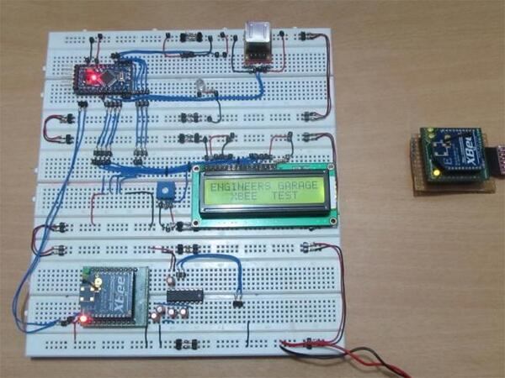
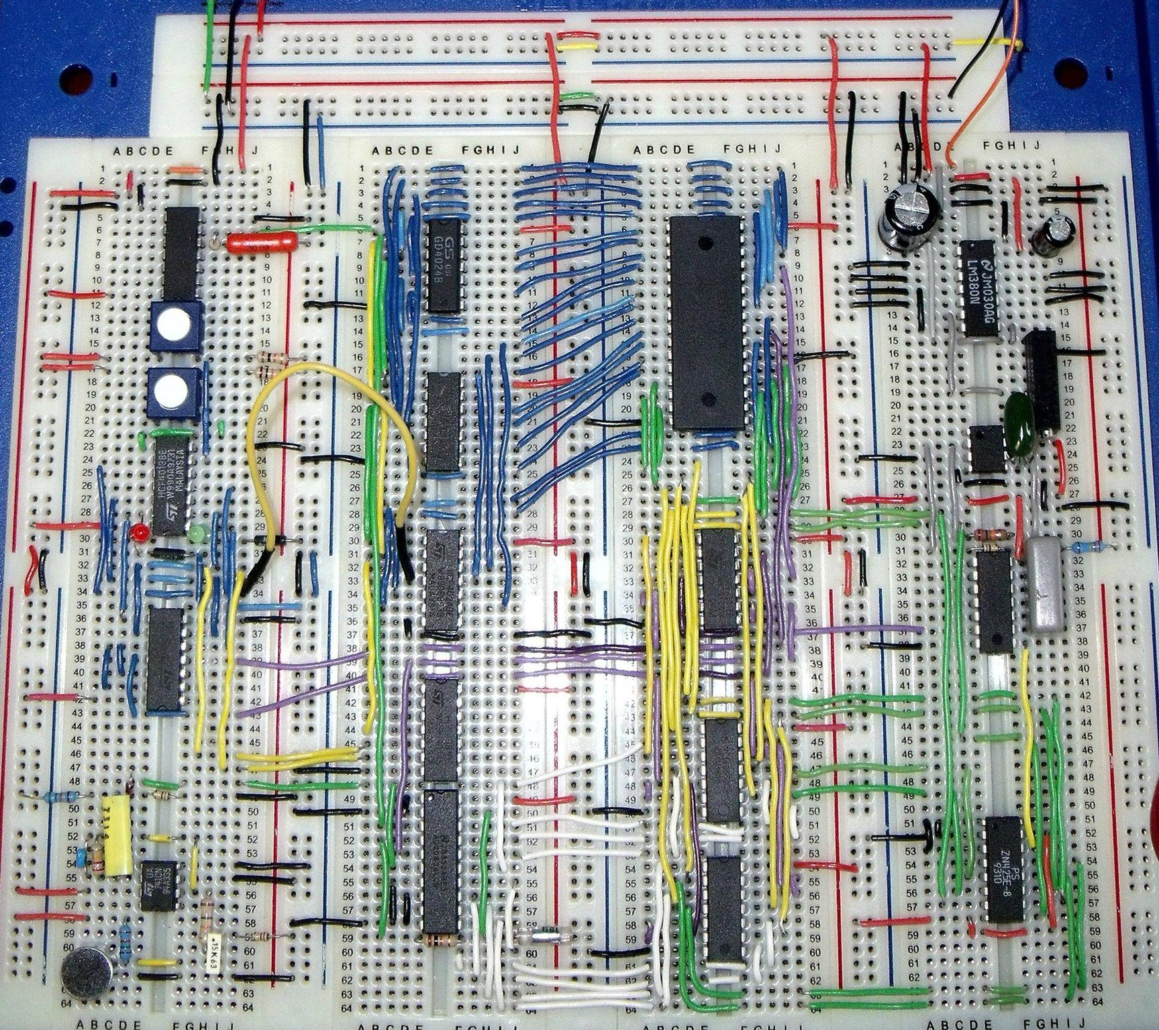
Breadboards
Lots of ways to wire a breadboard.
There is no “right” way as long as it works.

Slide 5
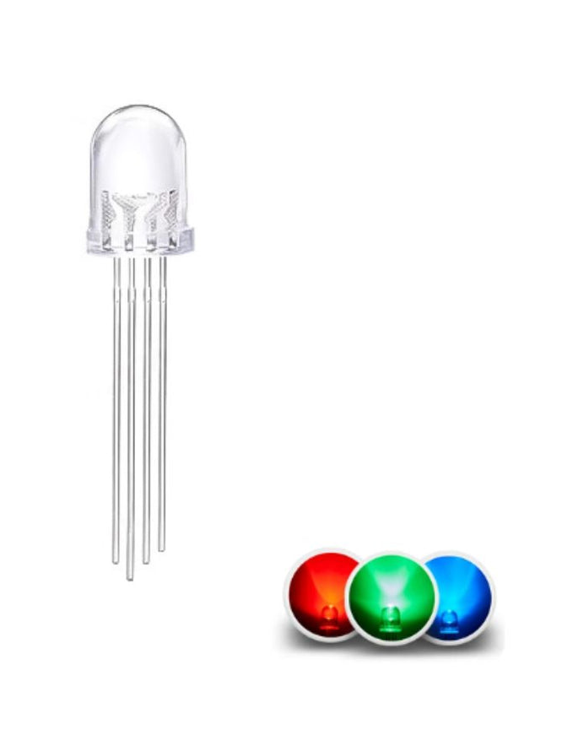
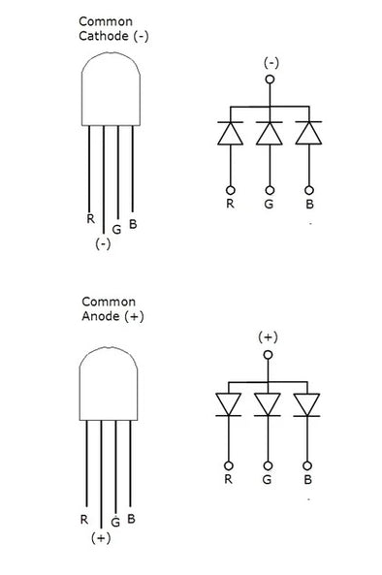
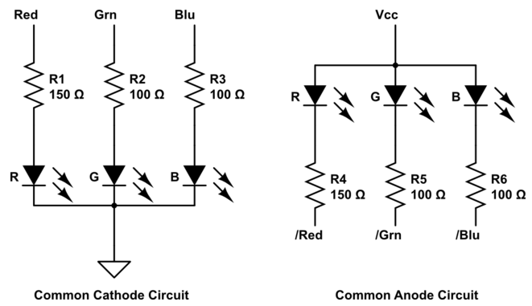
RGB LED
Multi-color LEDs often come packaged with 3 independent pins and 1 common pin.
Common Anode connects the positive sides together
Common Cathode connects the negative sides together

Slide 6
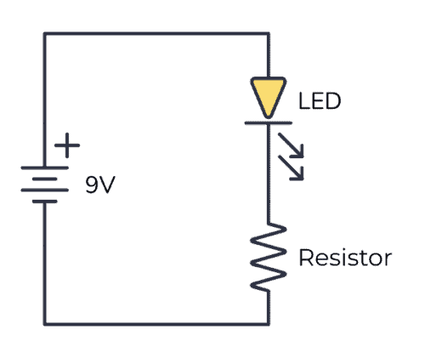
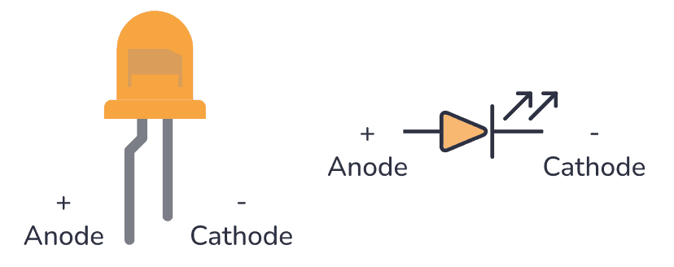
RGB LED Wiring
There are many ways to connect these diodes. The chosen method will depend on the goal and the low level electrical requirements of the LED.
Current Flow
+
The Forward Voltage is the. Amount of “voltage drop” across the diode
-
+
The resistor also has a “voltage drop”. In this circuit it acts as a current limiter.
-

Slide 7
RGB LED Wiring
The LED’s electrical parameters need to be taken into account when wiring the circuit.
In addition, the Microcontroller will also have electrical limits for what it can source or sink.

Slide 8
BME280
Environmental Sensor

Slide 9
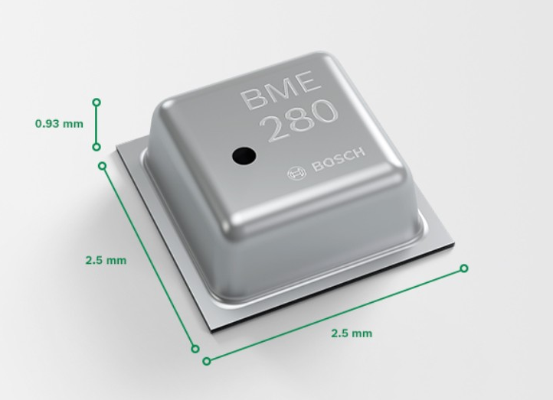
Bosch Sensortec BME280
The BME280 is a humidity sensor especially developed for mobile applications and wearables where size and low power consumption are key design parameters. The unit combines high linearity and high accuracy sensors and is perfectly feasible for low current consumption, long-term stability and high EMC robustness. The humidity sensor offers an extremely fast response time and therefore supports performance requirements for emerging applications such as context awareness, and high accuracy over a wide temperature range.
Parameter | Technical data
Operation range | Pressure: 300...1100 hPa Temperature: -40…85°C
Supply voltage VDDIO Supply voltage VDD | 1.2 ... 3.6 V 1.71 ... 3.6 V
Interface | I²C and SPI
Average current consumption (typ.) (1Hz data refresh rate) | 1.8 μA @ 1 Hz (H, T) 2.8 μA @ 1 Hz (P, T) 3.6 μA @ 1 Hz (H, P, T) T = temperature
Average current consumption in sleep mode | 0.1 μA
Humidity sensor Response time (τ63%) Accuracy tolerance Hysteresis | 1 s ±3% relative humidity ≤2% relative humidity
Pressure sensor RMS Noise Sensitivity Error Temperature coefficient offset | 0.2Pa (equiv. to 1.7cm) ±0.25% (equiv. to 1m at 400m height change) ±1.5Pa/K (equiv. to ±12.6cm at 1 °C temperature change)
RoHS compliant, halogen-free, MSL1
Package dimensions | 8-Pin LGA with metal 2.5 x 2.5 x 0.93 mm³
Link to product page
Link to Datasheet

Slide 10
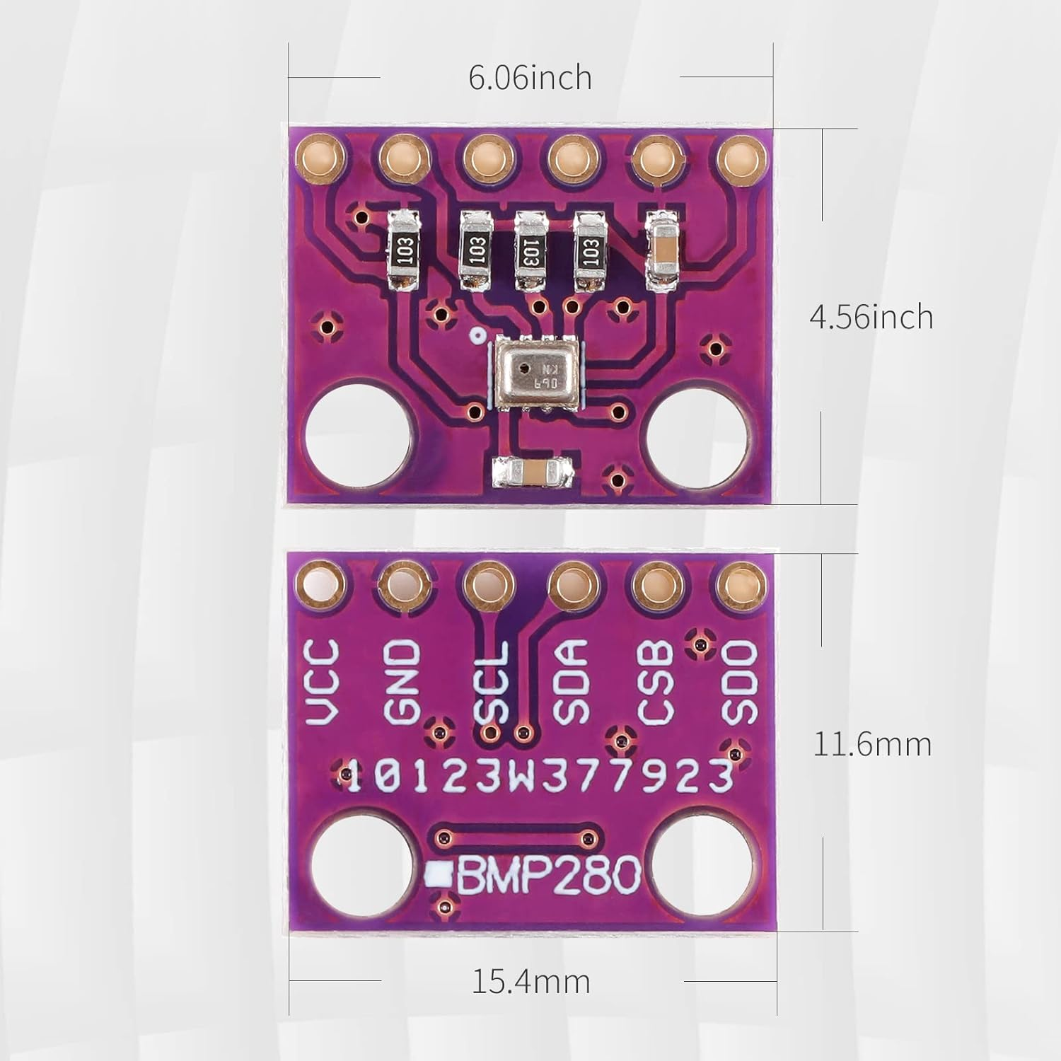
Bosch Sensortec BME280
The sensor module is pictured here.
VCC is connected to 3.3V
GND is connected to Ground
SCL is the SPI Clock
SDA is the SPI MOSI Signal
SDO is the SPI MISO Signal
CSB is the SPI Chip Select
Top
Bottom
Link to product page
Link to Datasheet

Slide 11
Bosch Sensortec BME280
The sensor module is pictured here.
VCC is connected to 3.3V
GND is connected to Ground
SCL is the SPI Clock
SDA is the SPI MOSI Signal
SDO is the SPI MISO Signal
CSB is the SPI Chip Select
Top
Bottom
Link to product page
Link to Datasheet

